Slide 1
SIPREC An Architecture for Media Recording using the SIP
IETF INTERIM MEETING
Leon Portman
on behalf of the team
Draft authors: A. Hutton, L. Portman, R. Jain, K. Rehor

Slide 2
Agenda
Location of Session Recording Client
Establishment the Recording Session
Additional Flows
Open Issues
Next Steps

Slide 3
B2BUA as SRC
A SIP B2BUA which has access to the media that is to be recorded may act as a Session Recording Client.
Open items
Does SRC always reports metadata?
Mandatory metadata in INVITE headers
+-----------+
(Recording Session) | |
+----SIP-------->| Recording |
| | Server |
| +----RTP---->| (RS) |
| | +-----------+
V | ^
+-------------+ |
| | |
| |--- MetaData -+
| |
| B2BUA |
| |
| Recording |
+--------+ | Client | +---------+
| |<- SIP ->| |<- SIP ->| |
| UA-A | | | | UA-B |
| |<- RTP ->| |<- RTP ->| |
+--------+ | | +---------+
+-------------+
(Communication Session) (Communication Session)

Slide 4
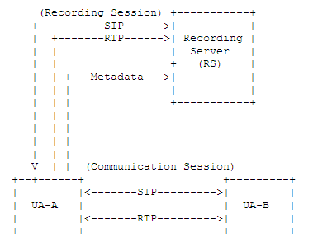
Endpoint acts as SRC
A SIP Endpoint / User Agent may act as a Recording Client in which case the endpoint sends the Replicated Media to the Recording Server
Open items
Media codec negotiation (Issue #4)
Dynamic codec negotiation (issue #21)

Slide 5
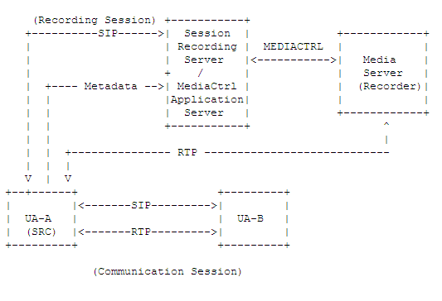
Mediactrl (RFC5567)
Use case: AS controls MS for conferencing/recording
SRS can be implemented by using MEDIACTRL (MS as recorder)
B2BUA SRC can be implemented by using MEDIACTRL (MS as conference server)
Same for Conference Focus
Open items:
Applicability of MEDIACTRL as Recording Session Protocol between SRC and SRS

Slide 6
Establishment the Recording Session
SRC Initiated Recording
RC initiates the recording session by sending an INVITE request to the SRS.
Useful where recording decision is made by the RC.
SRS Initiated Recording
RS initiates the recording session by sending an INVITE request to the SRC.
Useful where recording decision is made by the SRS.
Open issue: persistent recording flows (issue #6)
Which CS identifier will be used for Persistent RS?

Slide 7
Media Recording Metadata
Content
Dialog identifiers for the Communication Session
Identities of users taking part in the Communication Session
Dialog state of the Communication Session
Session state relating to the Communication Session(i.e. sendonly, inactive, sendrecv).
Mechanisms for delivery:
Event package (outside RS SIP session)
INFO package (inside RS SIP session)
INVITE Headers (issue #17)
Webservice
Open Items
Communication Session identifier
Mandatory data elements

Slide 8
Multi-party Conference Recording
B2BUA SRC (conference server)
Mixed media stream for all participants
Single Media stream per participant
Single Metadata reporting
Hidden SRS as one of the participants
Endpoint SRC
Mixed media stream for all other participants
Multiple SRCs (per participant)
Multiple Metadata Reports
Multiple recording notifications
B2BUA SRC (in front of Endpoint)
Similar to Endpoint SRC

Slide 9
Additional Flows
Pause/Resume Recording Session
Changing the SDP direction attribute to "inactive" and resume the recording by changing the direction back to "sendonly" or "recvonly”
Media Stream Mixing
SDP must describe all separate streams
Notifications to the Recorded User Agents (issue #2)
Session Recording Client must provide notifications on the Communication session.
Preventing the recording of a SIP session
UA must be able to indicate that recording is not allowed.
Some sessions MUST be recorded.

Slide 10
Next Steps
Adopt as working group item

Slide 11
Discussion

